Slide 1
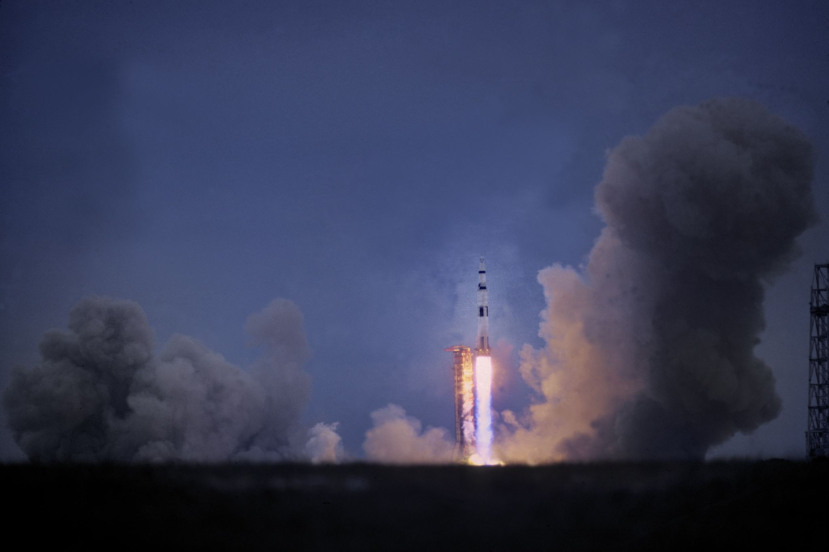
SpaceX Falcon 9: Predicting Successful First Stage Landings
Venkatesh Vuyyala
06/04/2024

Slide 2
Outline
Executive Summary
Introduction
Methodology
Results
Conclusion
Appendix

Slide 3

Executive summary
The project focuses on predicting the successful landing of SpaceX's Falcon 9 rockets' first stage. SpaceX's ability to reuse the first stage significantly reduces costs compared to other providers, offering its rockets at $62 million, while others charge $165 million.
Employed techniques such as API integration and web scraping for initial data gathering, followed by data wrangling and exploratory data analysis (EDA) with visualization to uncover hidden insights and trends. Subsequently, I utilized feature engineering for data preprocessing before applying four distinct machine learning algorithms for predictive modeling
The results from these algorithms demonstrated consistent accuracy, achieving approximately 83.33%.

Slide 4

Introduction
As a data scientist at SpaceY, a rocket company founded by billionaire Allon Mask, my primary task is to leverage publicly available information regarding our competitor, SpaceX, to determine the likelihood of successful first-stage landings for their rockets. This critical insight will enable SpaceY to strategize effectively and compete with SpaceX in the bidding process.
Data Collection: Initiated research by gathering public data from SpaceX's API using HTTP requests and Beautiful Soup. Transformed the collected data into a structured Pandas table for further analysis.
Data Wrangling and Analysis: Utilized Pandas for data wrangling and restructuring to ensure data quality and consistency. Conducted analysis using SQLite, Matplotlib, and Seaborn to explore relationships between various features and the success of first-stage landings.
Data Visualization: Employed Folium for geospatial visualization of launch sites, providing valuable insights into geographical factors. Utilized Dash to develop interactive dashboards, facilitating exploration of hidden relationships, such as the impact of payload mass and orbit type on landing success rates.
Predictive Modeling: Implemented classification-based predictive modeling techniques using Logistic Regression, Support Vector Machine, Decision Tree, and K-Nearest Neighbors algorithms. Employed GridSearchCV for hyperparameter tuning to enhance model performance.
The dataset exhibits a class ratio of 66.67% for successful landings (class 1), and the predictive models achieved an impressive accuracy of 83.33% in correctly predicting these successful outcomes.

Slide 5
Methodology
1. Data collection through an API
2. Webscraping using Beautiful Soup
3. Data Wrangling with Pandas
4. Analyzing the data using SQLITE
5. Creating DashBoard fro Spacex
6. EDA using matplotlib and seaborn for visualizing hidden patterns.
7. Predictive modeling using four(4) different machine learning algorithms

Slide 6
Data Collection
• After a thorough research(reading) about SpaceX, I decided to use their publicly free API using HTTP python library to get the data in a json format. I then converted the json result into a data frame to extract all necessary information that will be useful to my analysis. I filtered all “Falcon 1” data remaining with only “Falcon 9” which is of most interest due to its successfully landing history over the past years. I cleaned all missing values at this early stage leaving only LaunchingPad with nulls indicating when no LauchPad was used during the launching process.
Here is a flow chart to show the process:
API request
Data Frame
Data Cleaning
Save/export cleaned data

Slide 7
Data Collection SpaceX API
SpaceX URL , response, Json, Data Frame
Spacex-Datacollection-API
SpaceX_URL
response
Response Content
Status Codes
Json
Helper function
Data frame

Slide 8
Data Collection- Web Scraping
Static URL, Beautiful Soup, Data frame
Github-Webscraping
Static URL
Request get text
Beautiful Soup
Tables
Column names
Helper Function
Data Frame

Slide 9
Data Wrangling
• The cleaned data was first imported, and I checked what percentage of missing values is in the LaunchingPad since it was the only column still containing missing value indicating when “no LaunchingPad” was used. I then checked the datatype of each column, there are 4 different datatypes(int64, object, float64 and bool). Further analysis like value count of LaunchSite was also examined for the various facilities Cape Canaveral Space Launch Complex 40 VAFB SLC 4E seem to have the highest count of 55.
• I created a new feature called “class” from the outcome's column were all outcome containing the name “False” and “None” are regarded as bad, therefore a of zero(0) was assigned and one(1) for good outcome.
• I also calculated the success rate of all the good outcome which make up 66.67% of the class feature.
Github-DataWrangling

Slide 10
EDA with Data Visualization
I extensive utilized seaborn and matplotlib for the visualization of static charts, plot type such as catplot for displaying the relationship between PayloadMass vs LaunchSite, barplot for orbit vs class and line plot to show the trend of average success rate of rocket launches over time(2010-2020).
EDA-Github-notebook

Slide 11
EDA with SQL
Names of Unique launch sites in the space mission
Five records where launch sites begin with string ‘CCA’
Total payload mass by NASA (CRS)
Average payload mass carried by booster version F9 v1.1
First successful landing outcome in ground pad
Success in drone ship, payload mass >4000 but < 6000
Total number of successful and failure mission outcomes
Booster_versions with maximum payload mass
Month names of failure landing outcomes in drone ship in year 2015
Landing outcome counts between "2010-06-04" and "2017-03-20“ in descending order
EDA with SQL Github

Slide 12
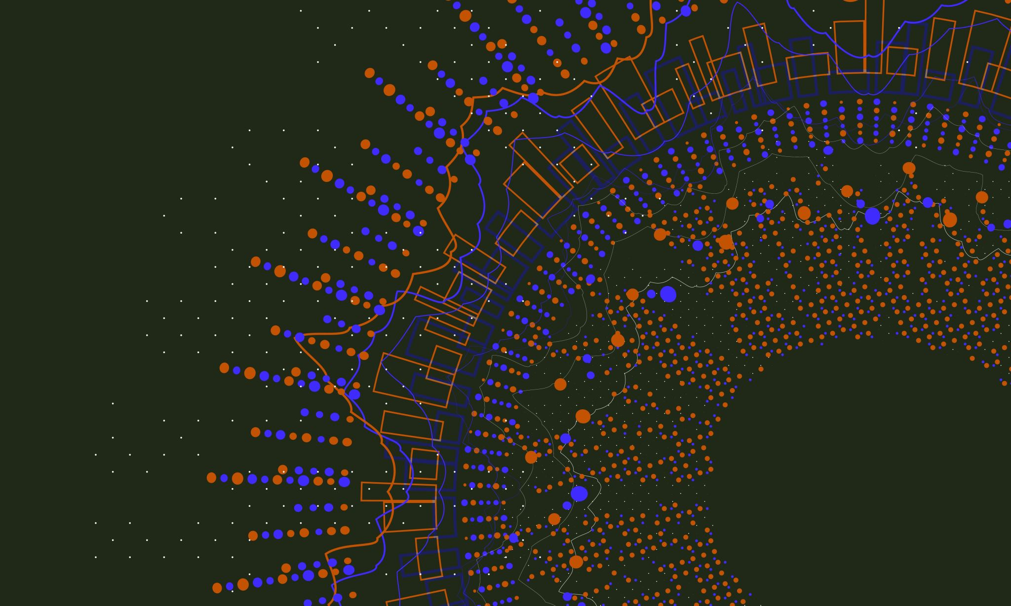
Build an Interactive Map with Folium
In the interactive map created with Folium, I included various objects for enhanced visualization:
Markers: These are used to pinpoint the exact locations of the launch sites, such as the NASA JSC Space Center launch site.
Circles: These highlight specific areas with a text label at designated coordinates.
Lines: These represent the proximity between different launch sites.
Interactive maps- Github

Slide 13
Build a Dashboard with Plotly Dash
In the Plotly Dash user application I have added a dropdown list and a range slider to allow a user to interact with a pie chart and the scatter point chart
Github-Dashapp

Slide 14
Predictive Analysis (Classification)
The cleaned data was imported, and I assigned the features to a variable (X), and target to the variable(Y). The features were then scaled using sklearn’s the standard scaler() object, split with inbuilt “train_test_split” with a portion of 20% assigned to the testing.
The models were instantiated, hyperparameters assigned using “GridSearchCV” for optimal best performing parameters.
Fitting was done on the training-set while the evaluation on the unseen test-set, the “DecisionTreeClassifier” models achieved the best results with an accuracy of 88.88% and F1-score of 88.21% using “GridSearchCV” for hyperparameter tuning.
Prediction Analysis-Github
Import data
Feature Engineering
Splitting The data
Modeling
Evaluate

Slide 15
Results
The finding of the exploratory stage were quite interesting with NASA (CRS) having a total “payload mass” of 45,596, average payload_mass of “booster version F9 v1.1” is 2928.4, first successful landing outcome ground pad was achieved in “2015-12-22”, and up to 5 Booster_version having a successful landing_outcome on “drone_ship” with payload_mass between (4000,6000). A total of 99 success mission_outcome was also achieved by SpaceX’s Falcon 9.
The visualization also depict some interesting findings, with higher success rate for CCAFS SLC 40 as the filight number increases, and higher success rate(100%) of Falcon 9 landing for Obit type “ ES-L1, SSO, HEO and GEO). Also there has been tremendous success in Falcon 9’s first stage landing over time since 2010 to 2020.

Slide 16
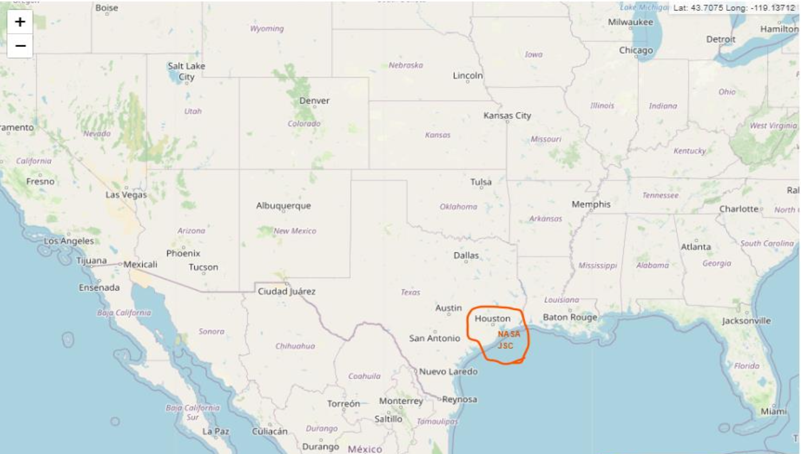
Results
Nasa Johnson Space Station
(NASA JSC)
Source: Interactive maps- Github

Slide 17

Results
I employed four different machine learning algorithms: baseline Logistic Regression, Support Vector Machine, Decision Tree classifier, and KNN. All models demonstrated strong performance, achieving accuracies above 83%. The Decision Tree model, optimized with GridSearchCV, attained the highest accuracy of 88.89% and an F1-score of 88.21%. This indicates that our model can accurately predict the success of Falcon 9 first-stage landings 88.89% of the time.

Slide 18

Insights From Exploratory Data Analysis

Slide 19
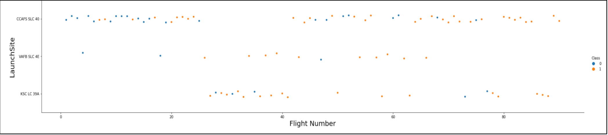
Flight Number vs. Launch Site
As show above the relationship between Flight Number and LaunchSite, we can see that with
lower flight number (20) there’s no failure or success metric for “KSC LC 39A”, but two
failures for the “VAFB SLC 4E”. But as the flight number increases past 80, there are more
success “CCAFS SLC 40” and none for “VAFB SLC 4E”.

Slide 20
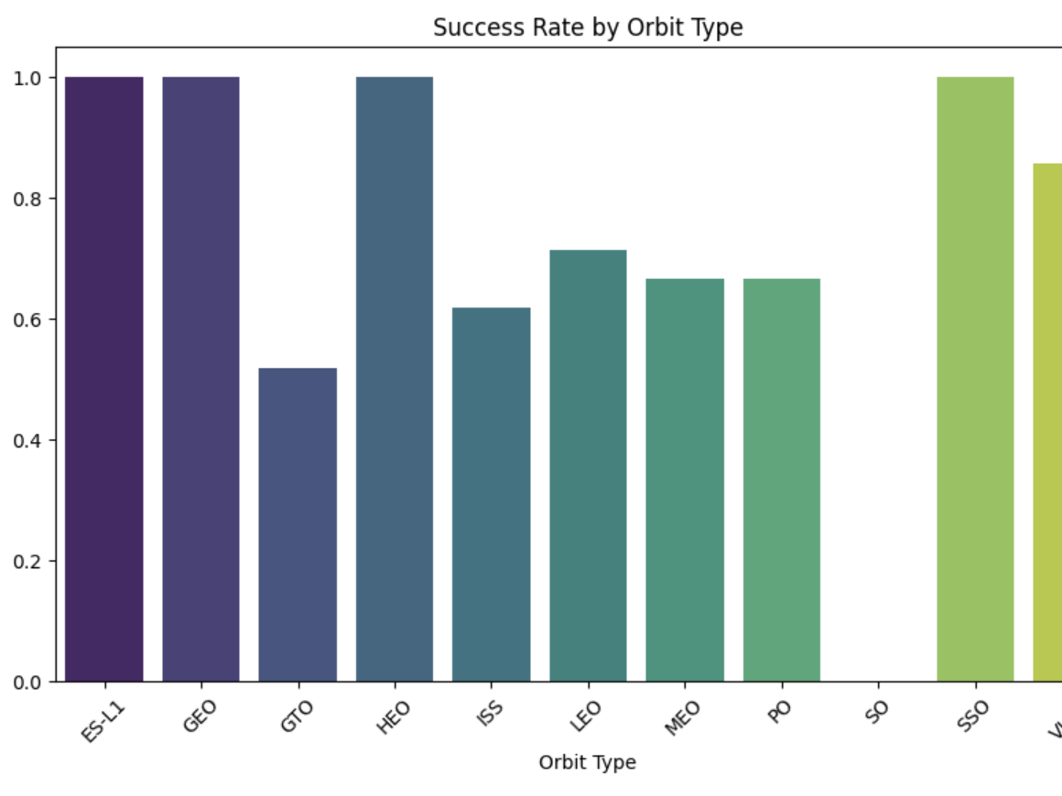
Success Rate vs. Orbit Type
Four(4) Orbit type have the
highest success rate of 100%
ES-L1, SSO, HEO, and GEO.

Slide 21
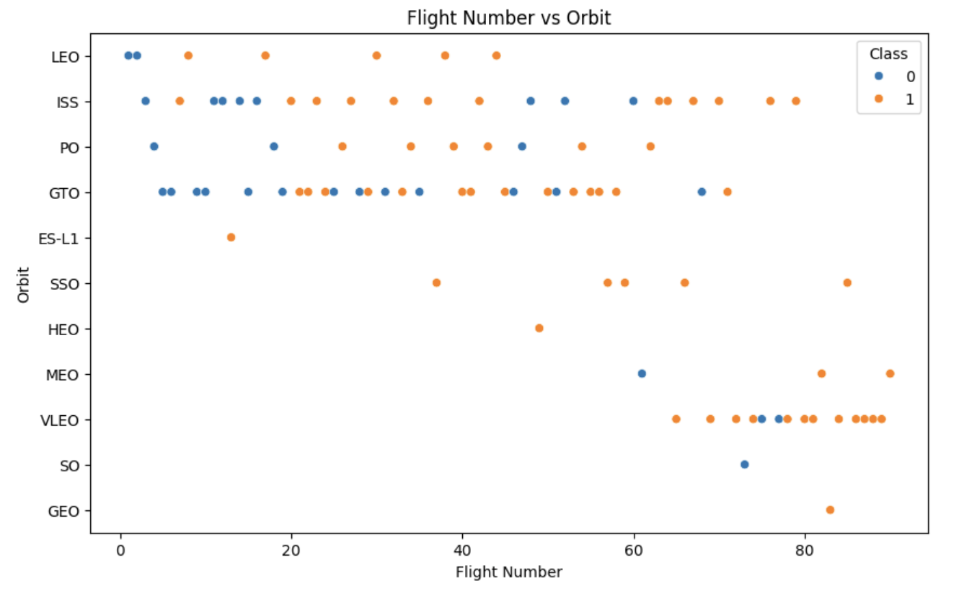
Flight Number vs Orbit
You can see that in the VLEO orbit there seem to be success rate only when the flight
number is greater than 60. While there seem to be no relationship in the GTO.

Slide 22
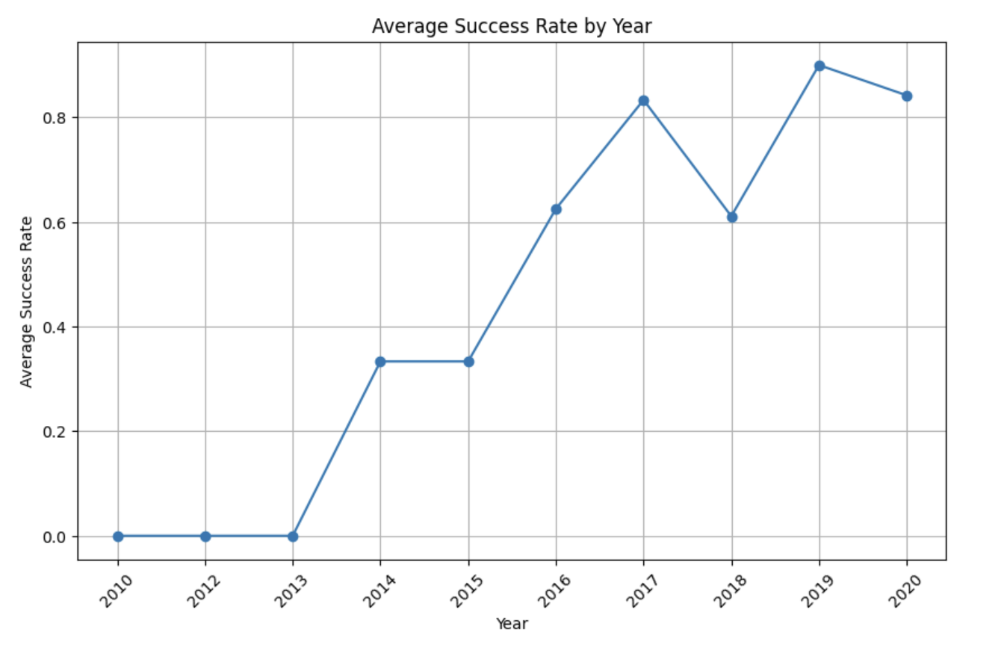
Launch Success Yearly Trend
The yearly success rate
of Falcon 9 landing kept
increasing since 2013
till 2020.

Slide 23
All Launch Site Names
• The name of unique launch sites are:
Source: GitHub
All Launch Site Names
CCAFS LC-40: Space Launch Complex 40 formerly Launch Complex 40 ( LC-40 ) is an orbital launch
pad located in northern Cape Canaveral , Florida (Wikipedia).
VAFB SLC-4E: Vandenberg AFB Space Launch Complex 4 is a launch and landing site at Vandenberg Space
Force Base, California, U.S. It has two pads, both of which are used by SpaceX for Falcon 9, one for launch
operations, and other as Landing Zone 4 for SpaceX landings(Wikipedia).
KSC LC-39A: Kennedy Space Center Launch Complex 39A Launch Complex 39A is the first of Launch
Complex 39's three launch pads, located at NASA's Kennedy Space Center in Merritt Island,
Florida(Wikipedia).

Slide 24
Launch Site Analysis

Slide 25
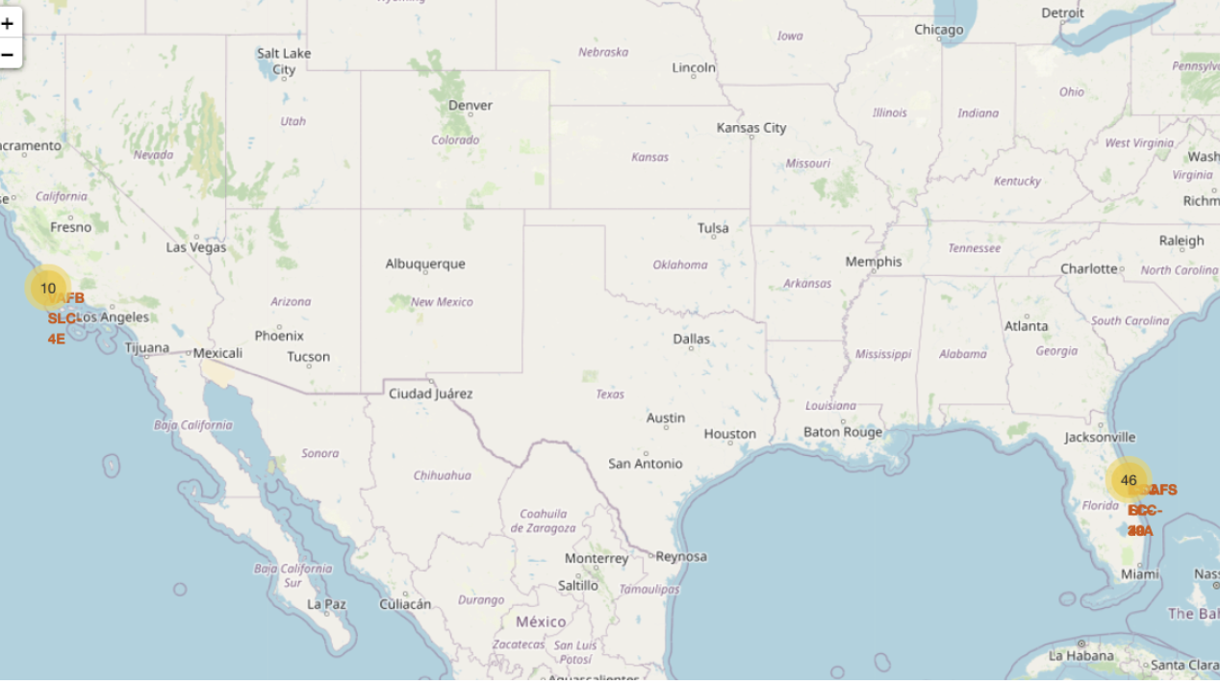
Proximities

Slide 26

Build a SpaceX DashBoard

Slide 27
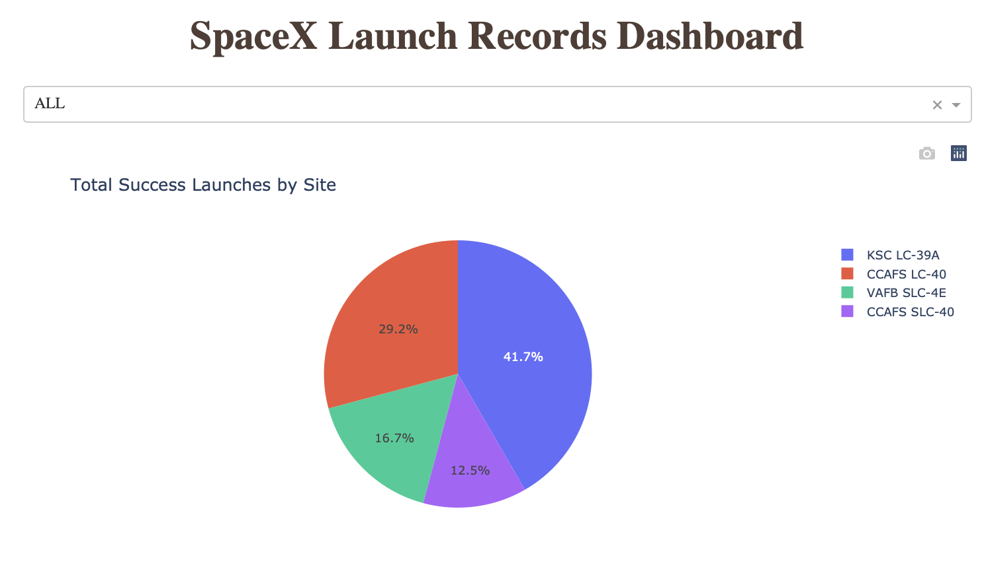
Pie chart of all the launch sites
KSC LC-39A makes up 41.7% of the pie chart showing it has more launches than the other sites, followed by CCAFS LC-40 with 29.2%

Slide 28
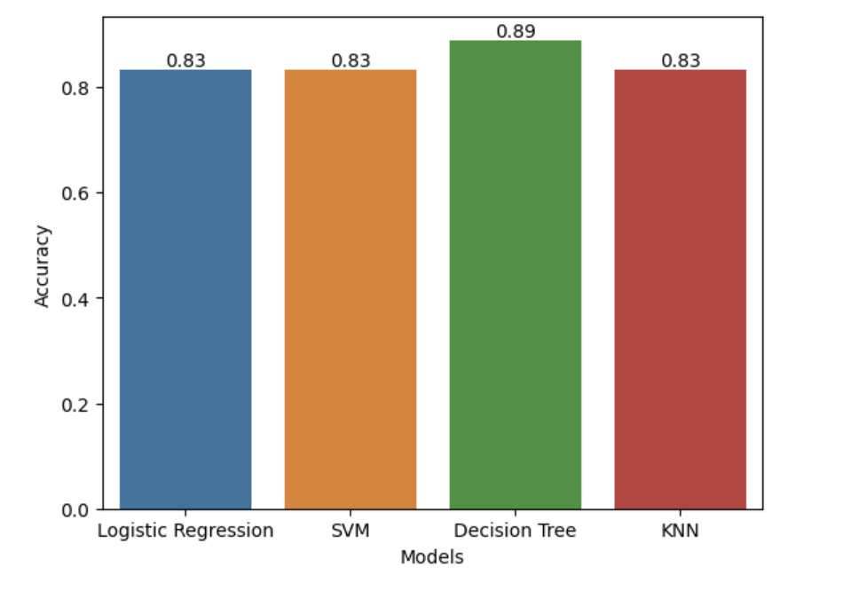
Predictive Analysis Classification
Decision Tree was the best classifier
with and accuracy of 88.88%

Slide 29
Conclusions
Launch Site CCAFS SLC 40 exhibits a higher success rate as the flight number increases, indicating a positive correlation between flight number and success rate.
Similarly, there is a positive relationship observed between payload mass and success rate at this launch site.
Orbit types ES-L1, SSO, HEO, and GEO demonstrate a 100% success rate for landing, highlighting the reliability of these orbit types.
Over the period from 2010 to 2020, there has been a consistent increase in the success rate of Falcon 9 landings, indicating an overall improvement in landing performance over time.
With an impressive accuracy of 88.89%, our model demonstrates a high level of confidence in predicting the outcome of Falcon 9 landings

Slide 30

Appendix
All relevant Sources and Notebooks are available in Github - Spacex_Falcon9

Slide 31
Thankyou

